Slide 1
CAOS Match4 Project
TIM BACHMANN, DANIEL WEISSEN

Slide 2
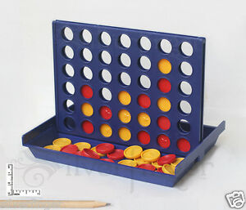
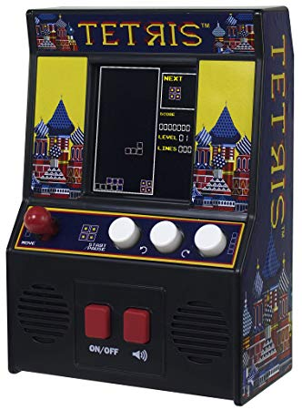
Our Goal
Electronic Match4 Game
Displayed on LED Matrix
Controlled with 7 Buttons
Inspired by arcade machines

Slide 3
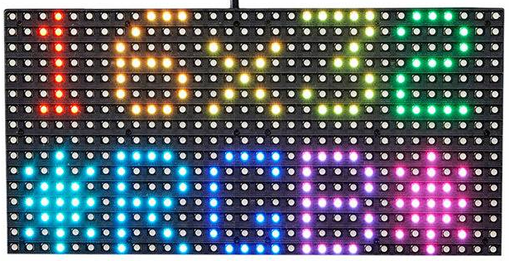
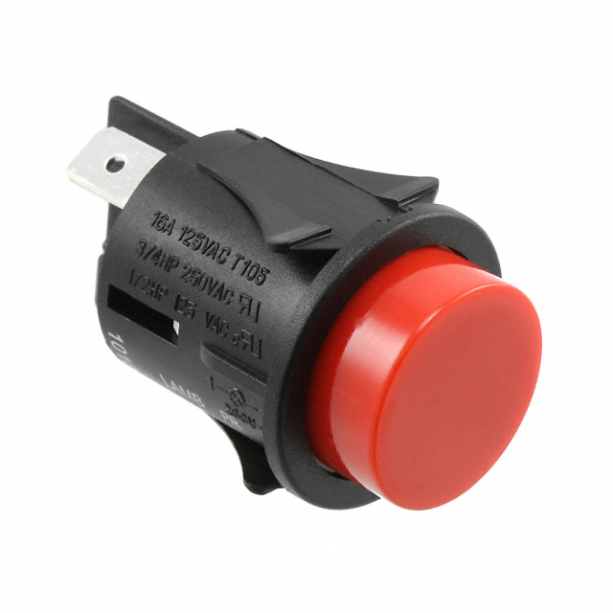
Material used for the project
Arduino Uno
Adafruit LED 32x16 RGB Matrix
Power supply for LED Matrix
Red Buttons (SWITCH PUSH SPST-NO 16A 125V)
Jumper Wires

Slide 4
The initial development plan
Plan based on who has the Arduino at any given time:
Daniel writes the code for the match 4 game in C
Tim orders and assembles all the parts
Tim tests Daniels code with the Arduino and handles the input of the game
Daniel handles the output of the game and finishes up the project
Goal: Project finished before 2019 starts

Slide 5
Writing the match4 Code
Code written in C
Goal: get playable version of the game on console first
Relatively simple
A lot of issues with the code when trying to get it onto the Arduino

Slide 6
The assembly
In theory it should have been easy
In practice we had a lot of issues:
No power supply for the LED Matrix, assembly delayed
Connecting LED Matrix difficult due to different pin layouts
Not enough Ports on the Arduino to connect the 7 buttons, had to make it work with just 3

Slide 7

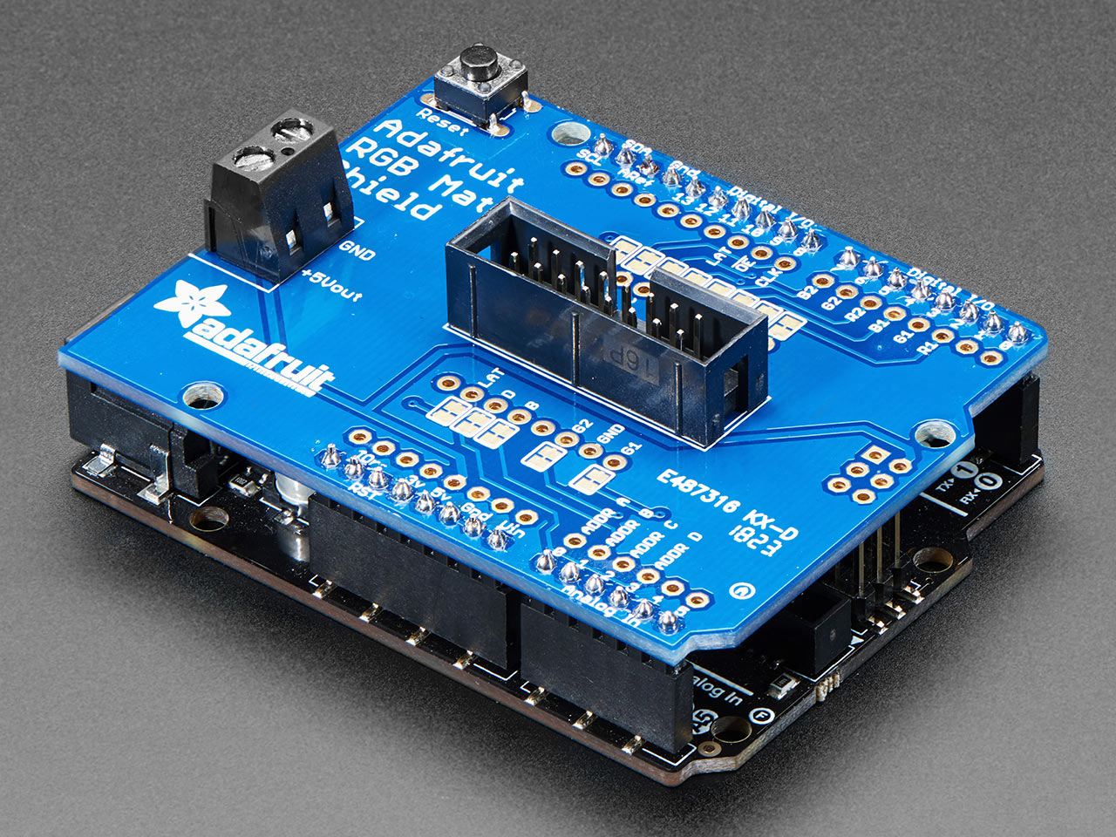
We probably should have bought this but we didn’t….
Connecting the LED Matrix

Slide 8
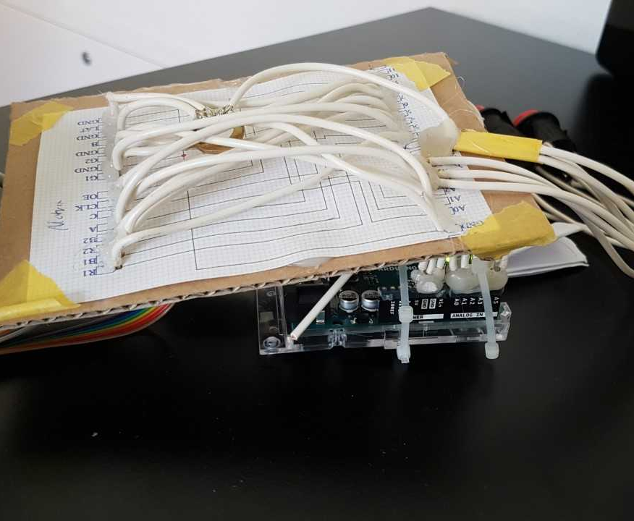
…so we had to make it ourselves

Slide 9
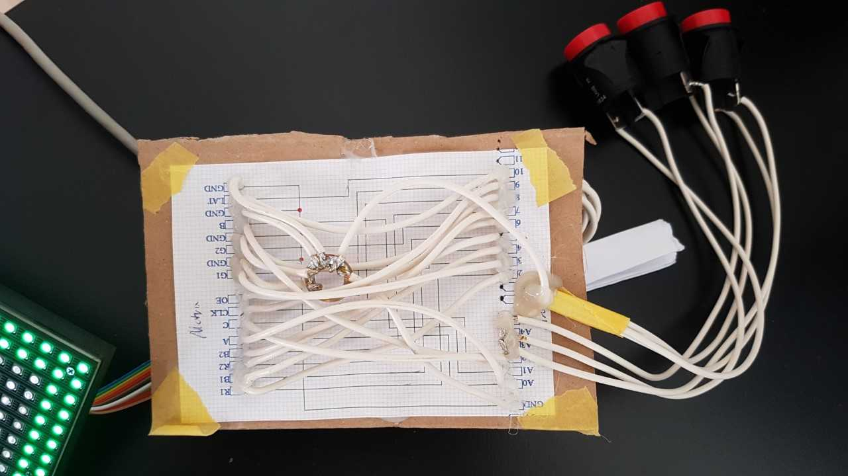

Slide 10
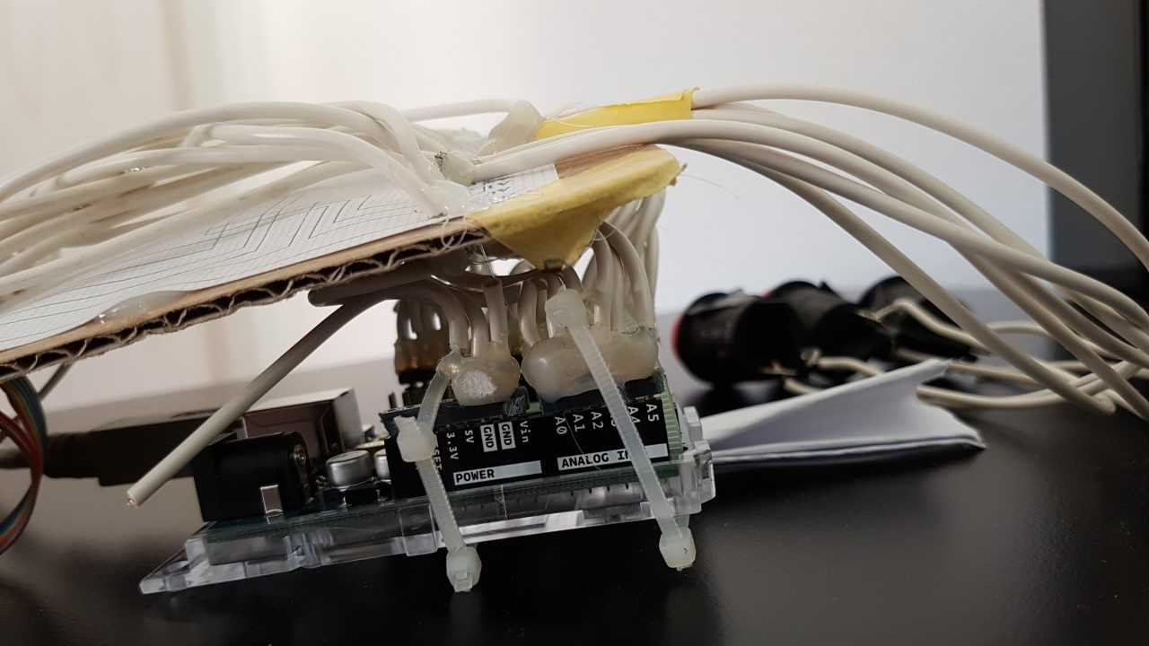

Slide 11
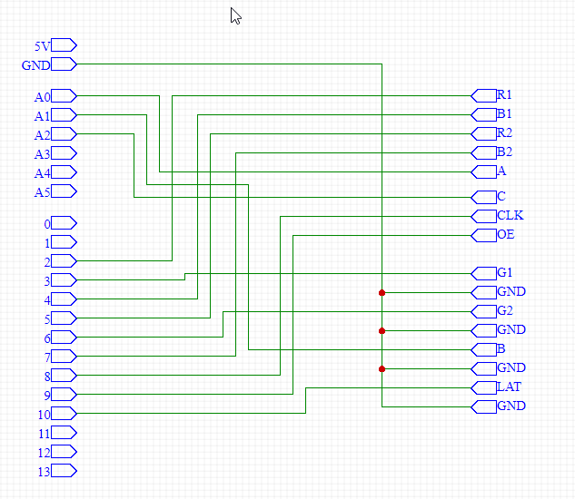
Schematics
Connection from the Arduino to the LED Matrix
Arduino on the left
LED Matrix on the right

Slide 12
Making the Input work
Buttons work slightly differently than the buttons we experimented with during the CAOS exercises:
Only two pins
Connected to analog pins
(no other pins free)

Slide 13
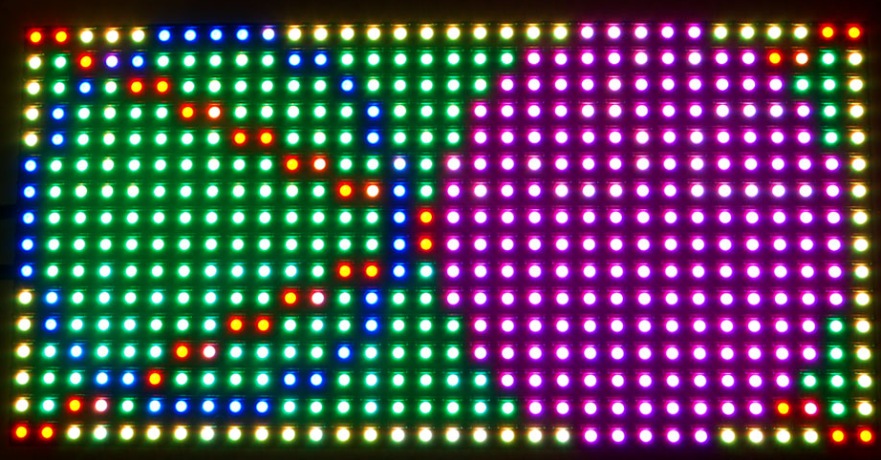
Using the LED Matrix
X=0,Y=0
Matrix manufacturer (Adafruit) offers a code Library to use the matrix
Using the Matrix, once connected, fairly straight forward
Code Example: drawPixel( xPosition, yPosition, RGB);

Slide 14
Getting the Match4 code on the Arduino
Code used too much memory for the Arduino, it had to be heavily altered:
A lot of Data types were changed to “signed char” to save memory
Code was simplified
Since the code assumed there would be 7 Buttons, it had to be adjusted to work with 3 Buttons
A lot of time/effort wasted rewriting the code

Slide 15
The finished Product

Slide 16
Live Demo

Slide 17
Reflecting on the Development
A lot of things went wrong:
Poor planning and research
We did not manage to follow our desired development schedule
Original code for the game did not work well with the Arduino
But a lot of thing went well too:
The initial goal we set to achieve was accomplished
We learned a lot of things during the development

Slide 18
What we learned
Buy parts as fast as possible, unpredictable delivery times can mess everything up
Do thorough research FIRST, no surprises/missing parts during assembly
Write code with System in mind the code will be running on
We learned a lot about memory management

Slide 19
Questions?

